Slide 1
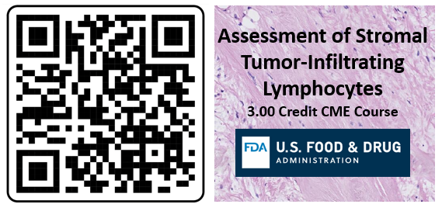
Assessment of Stromal Tumor-Infiltrating Lymphocytes 3.00 CME Credits
4 Part Course:
Clinical context of stromal tumor-infiltrating lymphocytes (sTILs)
Video on steps of the sTILs Assessment
Pitfalls in the sTILs Assessment
Manuscript on sTILs evaluation
(Salgado et al., Ann Oncol. 2015)
Create an account: https://ceportal.fda.gov/
Click on “Online Learning” tab
Scroll to “Assessment of Stromal Tumor-Infiltrating Lymphocytes”

Slide 2
Handout

